Slide 1


Ayelén Hidalgo Blasco
3 December 2024

Slide 2

Outline
Executive Summary
Introduction
Methodology
Results
Conclusion
Appendix

Slide 3
Executive Summary
Methodologies
Results
Data Preprocessing: We started by analyzing the SpaceX launch dataset, including features such as launch sites, payloads, booster versions, and landing outcomes. Data was cleaned, standardized, and split into training and test sets for model evaluation.
Exploratory Data Analysis (EDA): We explored correlations between different features and the success rate of rocket landings, visualizing data with pie charts, scatter plots, and confusion matrices to understand underlying patterns.
Model Development: We developed and compared multiple machine learning models, including:
Logistic Regression
Support Vector Machine (SVM)
Decision Trees
K-Nearest Neighbors (KNN)
Hyperparameter Tuning: Grid search was used to find the best hyperparameters for each model, improving prediction accuracy.
Model Evaluation: The models were evaluated on their test data using accuracy metrics, confusion matrices, and model performance comparison.
Best-Performing Models: The highest accuracy (83.33%) was achieved by Logistic Regression, SVM, and KNN. All of these models were highly effective in predicting launch success.
Confusion Matrix: The confusion matrix indicated that while the models performed well overall, some false positives (incorrectly predicting landings) and false negatives (missed landings) still occurred.
Conclusions: Predicting the success of rocket landings is achievable with a high degree of accuracy using the tested models. The models provide valuable insights into how SpaceX can optimize landing predictions, potentially lowering costs by improving first-stage reusability.

Slide 4
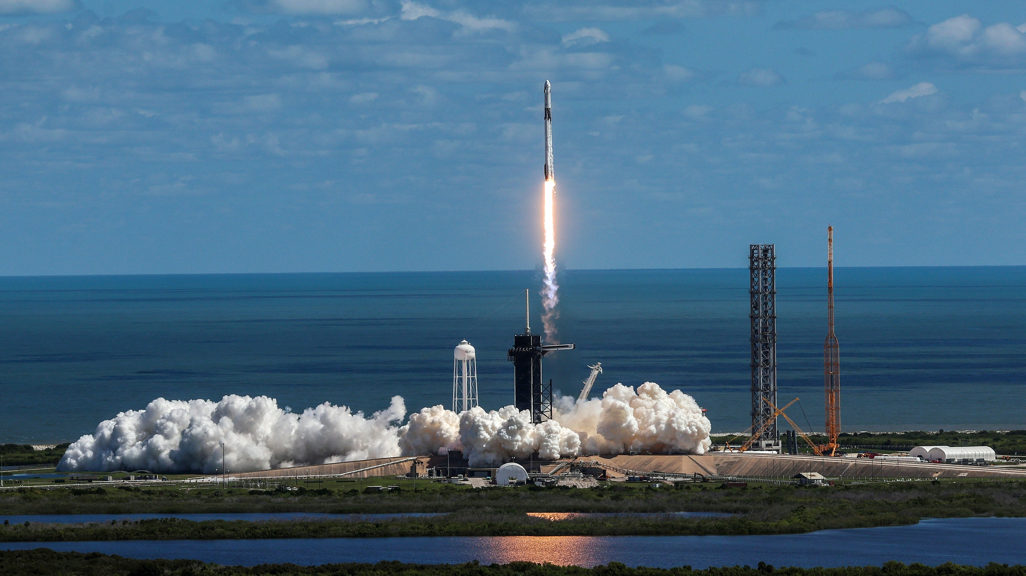
Introduction
SpaceX has revolutionized space travel by reusing the first stage of its Falcon 9 rockets, which significantly reduces the cost of space launches. The ability to predict whether a first-stage booster will land successfully is key to maximizing cost savings and operational efficiency.
This project leverages historical data from SpaceX’s rocket launches to build a machine learning model that predicts whether the first-stage booster will land successfully or not. This prediction can help SpaceX plan future launches more effectively by identifying when a booster is more likely to be reused, thus optimizing costs.
What Factors Affect Rocket Landing Success? We want to identify the key features (such as launch site, payload, booster version) that influence the success or failure of a rocket landing.
Can We Accurately Predict Landing Success? Can machine learning models predict whether a first-stage booster will land successfully, based on historical data, with high accuracy?
How Can This Prediction Improve SpaceX’s Operations? Can we provide actionable insights that will help SpaceX optimize its operations, reduce costs, and increase the reuse of Falcon 9 boosters?

Slide 5

Section 1

Slide 6
Provided consistent historical data for the project.
Data Collection
Data Sources
Methodology
Fetch Static JSON Data
Space X REST API
Static JSON Object
Accessed endpoints to retrieve detailed information on Falcon 9 launches
Provided consistent historical data for the project.
Load into DataFrame
Extract Relevant Columns
Enrich Data Using SpaceX API
Real time information about past launches
Technical details about de rockeys, launchpads, paylodas, etc.
Filter Falcon 9 Launches
Handle Missing Data
Save Clean Dataset

Slide 7
Data Collection – SpaceX API
Objective: Collect data from SpaceX launches using REST API
Initial API Call
/launches/past: Retrieve basic information about past launches (e.g., flight number, rocket ID, launch date, core ID, payload ID, launchpad ID).
Subsequent API Calls to enrich Data:
/rockets: Fetch booster name and specifications.
/launchpads: Get launch site details (name, latitude, longitude).
/payloads: Extract payload mass and orbit.
/cores: Gather information on core landing outcome, reuse count, landing pad, and core serial.
Combining and Cleaning Data
API Call to /launches/past
Extract IDs from Response
API Call to /rockets
API Call to /payloads
API Call to /launchpads
API Call to /cores
Combine Data into DataFrame
Reference: https://github.com/ayeee0110/Applied-Data-Science-Capstone-IBM-Course/blob/main/1-CollectingTheData.ipynb

Slide 8
Data Collection - Scraping
Objective: collect historical Falcon 9 launch data from the Wikipedia page
"List of Falcon 9 and Falcon Heavy launches."
Request HTML - Used requests.get() to fetch the Wikipedia page.
Parse HTML - Used BeautifulSoup to parse the HTML content.
Extract Column Names - Retrieved the table column names from <th> elements.
Extract Data - Iterated through the table rows (<tr>) to extract launch data (date, site, payload, etc.).
Create DataFrame - Converted the extracted data into a pandas DataFrame and exported it as CSV.
Request HTML
Parse HTML
Extract columns
Create Dataframe
Reference: https://github.com/ayeee0110/Applied-Data-Science-Capstone-IBM-Course/blob/main/2-WebScraping.ipynb

Slide 9
Provided consistent historical data for the project.
Data Collection
Resume of Key Dataframe Features obtained
Feature | Description
FlightNumber | Sequential number of the launch.
Date | Date of the launch.
BoosterVersion | Name/version of the booster.
PayloadMass | Mass of the payload in kilograms (mean-imputed for missing data).
Orbit | Orbital destination of the payload.
LaunchSite | Name of the launch site.
Outcome | Landing success or failure details.
Flights | Number of flights for the core.
GridFins, Legs | Boolean values indicating booster hardware usage.

Slide 10
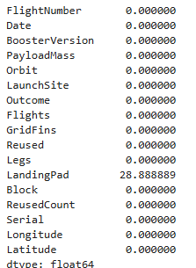
Data Wrangling
Handling Missing Values
Identify Missing Data: We identified missing values in the LandingPad column (28.89% of the data).
Handle Missing Data: missing values were left as NaN (no landing attempted).
Reference: https://github.com/ayeee0110/Applied-Data-Science-Capstone-IBM-Course/blob/main/3-DataWrangling.ipynb

Slide 11
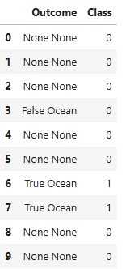
Data Wrangling
Categorical data transformation
The Outcome column had multiple values representing the success/failure of landings
Created a binary classification label (0 or 1) named Class based on landing outcomes:
1 = Successful landing.
0 = Unsuccessful landing.
Reference: https://github.com/ayeee0110/Applied-Data-Science-Capstone-IBM-Course/blob/main/3-DataWrangling.ipynb

Slide 12
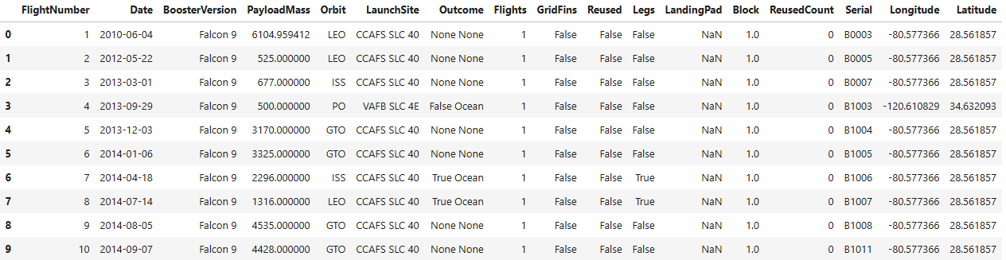
Data Wrangling
Data preprocessed and cleaned
Reference: https://github.com/ayeee0110/Applied-Data-Science-Capstone-IBM-Course/blob/main/3-DataWrangling.ipynb

Slide 13
EDA with Data Visualization
Scatter plots
Bar charts
Helped identify trends, relationships, and patterns between key variables like payload mass, launch site, and orbit type.
Provided a clear comparison of success rates for different orbit types, aiding decision-making.
FlightNumber vs. PayloadMass
FlightNumber vs. Lauch Site
PayloadMass vs. Lauch Site
FlightNumber vs. Orbit Type
PayloadMass vs. Orbit Type
Success rate of each orbit type
Line charts
Illustrated temporal trends
Lauch success yearly trend
Reference: https://github.com/ayeee0110/Applied-Data-Science-Capstone-IBM-Course/blob/main/4-EDA.ipynb

Slide 14
EDA with SQL
Unique lauch sites in the mission
5 records where lauch sites begin with ‘CCA’
Total payload mass carried by boosters launches by NASA (CRS)
Average payload mass carried by booster version F9 v1.1
Date when the first succesful landing outcome in ground pad was achieved
Names of the boosters which have success in drone ship and have payload mass greater than 4000 but less than 6000
Total number of successful and failure mission outcomes
Names of the booster_versions which have carried the maximum payload mass
Records which display the month names, failure landing_outcomes in drone ship, booster versions, launch_site for the months in year 2015
Ranking of the count of landing outcomes (such as Failure (drone ship) or Success (ground pad)) between the date 2010-06-04 and 2017-03-20, in descending order.
Reference: https://github.com/ayeee0110/Applied-Data-Science-Capstone-IBM-Course/blob/main/5-SQL.ipynb

Slide 15
Build an Interactive Map with Folium
Objective: Finding an optimal location for building a launch site certainly involves many factors and hopefully we could discover some of the factors by analyzing the existing launch site locations.
Markers
Markers are placed at the geographic coordinates of each launch site (e.g., CCAFS LC-40, KSC LC-39A, etc.) to visually indicate their locations.
Circles
Illustrate proximity areas for potential impact zones or safety buffers. Highlight geographical factors that might influence launch operations (e.g., avoiding urban areas).
Icones
Differentiate the performance of launches from each site visually (success/failure).
Lines
Quantify the distances between the launch sites and important landmarks. Enable analysis of how geographical proximity to the Equator, coastlines, or infrastructure affects launch success or operations.
Success: green marker.
Failure: red marker.
Help analyze patterns in the success or failure rates of launches geographically.
Other markers can be added for points of interest like railways, highways, or nearby cities (e.g., Titusville)
Reference: https://github.com/ayeee0110/Applied-Data-Science-Capstone-IBM-Course/blob/main/6-FoliumMaps.ipynb

Slide 16
Build a Dashboard with Plotly Dash
Pie Chart (Success Count by Site)
Scatter Plot (Payload vs. Launch Outcome)
Allows users to explore how payload mass might influence launch success, with data color-coded by booster version. This helps identify patterns between payload sizes, success/failure outcomes, and booster types.
Payload Range Slider
Allows users to filter the data and focus on a specific payload range. It's crucial for determining if there is a relationship between payload size and launch success rate.
Launch Site Dropdown
Enables users to compare the performance of different launch sites. They can select a specific site to analyze success rates or view data for all sites combined.
Helps users easily see he success rate of launches, either for all sites or for a specific site selected from the dropdown
Reference: https://github.com/ayeee0110/Applied-Data-Science-Capstone-IBM-Course/blob/main/6-spacex_dash_app.py

Slide 17
Predictive Analysis (Classification)
Objective: Predict the success of a rocket's first stage landing to assess mission costs.
Data Preparation
Input: Features representing mission data.
Target: Binary classification (Class: landed or not).
Preprocessing: Standardized features using StandardScaler.
Data Splitting
Split into training (80%) and test (20%) datasets for evaluation.
Model Training
Algorithms: Logistic Regression (LR), Support Vector Machine (SVM), Decision Tree, and K-Nearest Neighbors (KNN).
Used GridSearchCV for hyperparameter tuning with 10-fold cross-validation.
Evaluation
Metric: Accuracy on test data.
Confusion Matrices analyzed for false positives/negatives.
Precision: LR, SVM, and KNN achieved the same top performance.
Best Model Selection
Final model chosen based on highest accuracy and interpretability.
Logistic Regression emerged as the best due to simplicity and performance.
Start
Standarization of data
Data splitting
Data train
Data val
Model trainings
LR
SVM
Trees
KNN
Evaluation
Best model selection
End
Reference: https://github.com/ayeee0110/Applied-Data-Science-Capstone-IBM-Course/blob/main/7-%20PredictiveAnalysis.ipynb

Slide 18
Results
Exploratory data analysis results
Interactive analytics demo in screenshots
Predictive analysis results

Slide 19

Section 2

Slide 20
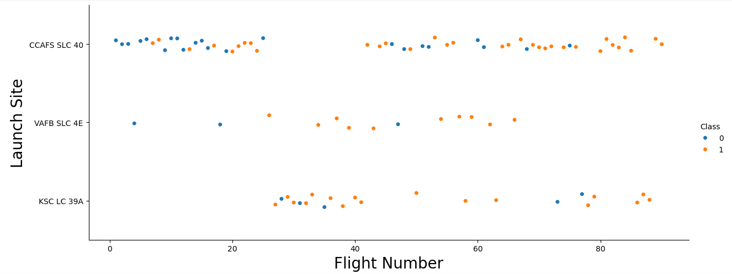
Flight Number vs. Launch Site
0
1
As the flight number increases, the first stage is more likely to land successfully
Landing site VAFB SLC 4E is most likely to be successful from flight numbers 50 and up, while at the other landing sites this occurs from flight numbers 80 and up.

Slide 21
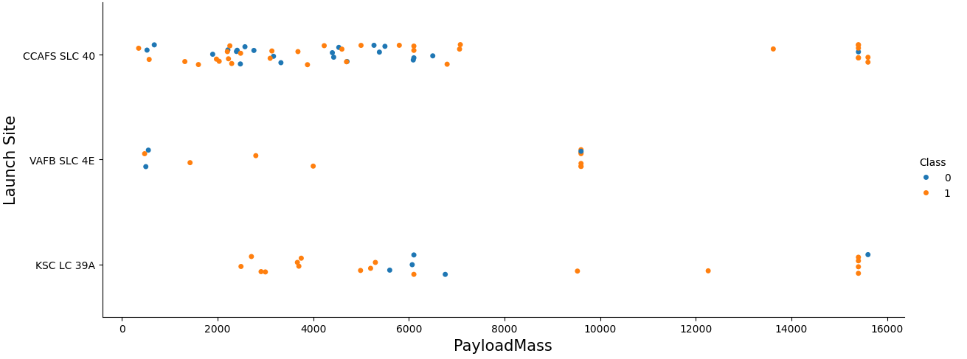
Payload vs. Launch Site
0
1
For the KSC LC 39A landing site the success rate is very high for payload masses less than 5000 and greater than 7000
For VAFB SLC 4E the success rate is higher for payload masses between 1000 and 9000
For CCAFS SLC 40 there is no clear relationship between payload mass and landing success at that site

Slide 22
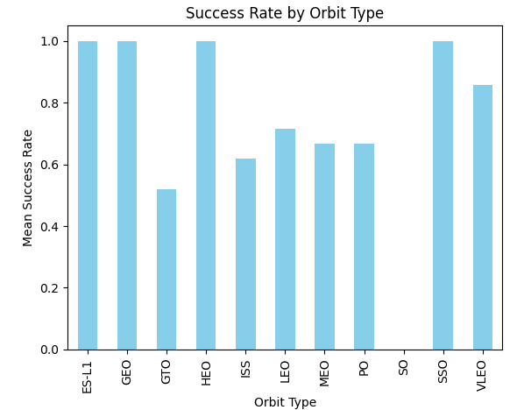
Success Rate vs. Orbit Type
The orbit types ES-L1, GEO, HEO, SSO are the ones with the highest success rate
GTO, ISS, LEO , MEO, PO and VLEO have an average success rate
SO has a zero success rate

Slide 23
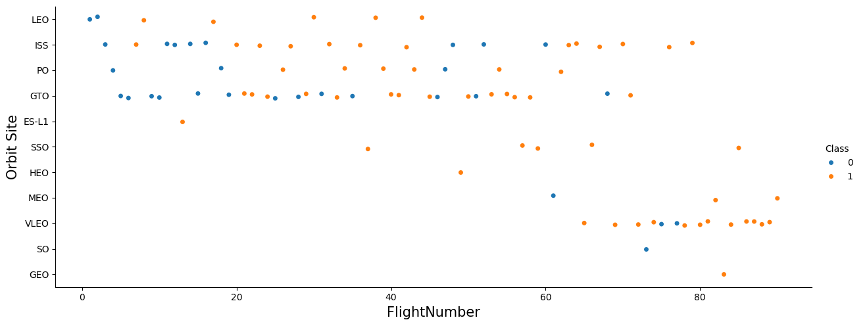
Flight Number vs. Orbit Type
0
1
For the orbits ES-L1, SSO y HEO independently of the Flight number la landing will be successful
For LEO orbit the success landing will happen for flight numbers over 10
For ISS orbit the success landing will happen for flight numbers over 60
For VLEO orbit the success landing will happen for flight numbers over 80
For the other ones there is not enough information or there is not a relationship between the orbit type, the flight number and the success of the operation.

Slide 24
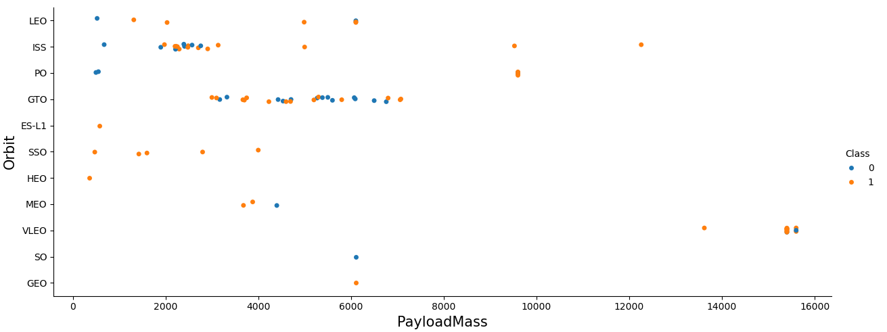
Payload vs. Orbit Type
0
1
For ES-L1, SSO, and HEO the landing will be successful for every payload mass.
For LEO the landing will be successful when the payload mass is over 1000
For ISS the landing will be successful when the payload mass is over 5000
For the other ones there is not enough information or there is not a relationship between the orbit type, the payload mass and the success of the operation.

Slide 25
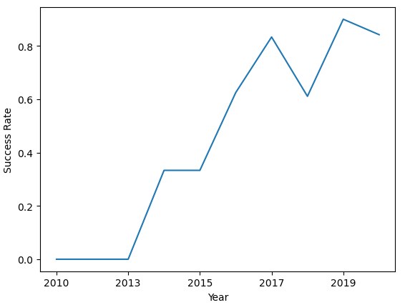
Launch Success Yearly Trend
Over the years the success rate has been increasing.
Currently it is approximately around 80% of success rate.

Slide 26
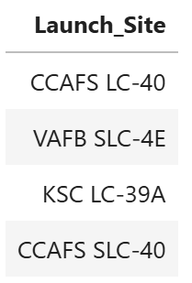
All Launch Site Names
SELECT DISTINCT Launch_Site FROM SPACEXTABLE
There are 4 different lauch sites:

Slide 27
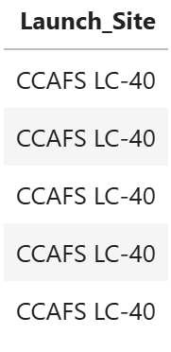
Launch Site Names Begin with 'CCA'
SELECT Launch_Site FROM SPACEXTABLE WHERE Launch_Site LIKE 'CCA%' LIMIT 5
The first 5 lauch sites beginning with ‘CCA’ are all of the type CCAFS LC-40

Slide 28
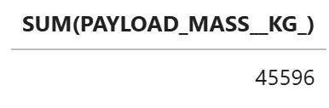
Total Payload Mass
SELECT SUM(PAYLOAD_MASS__KG_) FROM SPACEXTABLE WHERE Customer = ‘NASA (CRS)'
The total payload mass carried by boosters launched by NASA (CRS) is 45596 kg

Slide 29
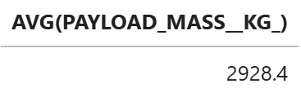
Average Payload Mass by F9 v1.1
SELECT AVG(PAYLOAD_MASS__KG_) FROM SPACEXTABLE WHERE Booster_Version = ‘F9 v1.1'
The avarage payload mass carried by booster version F9 v1.1 is 2928.4 kg

Slide 30
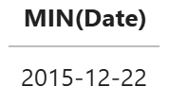
First Successful Ground Landing Date
SELECT MIN(Date) FROM SPACEXTABLE WHERE Landing_Outcome = ‘Success (ground pad)'
The date when the first succesful landing outcome in ground pad was achieved was the 22 of December of 2015

Slide 31
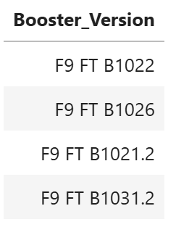
Successful Drone Ship Landing with Payload between 4000 and 6000
SELECT Booster_Version FROM SPACEXTABLE WHERE Landing_Outcome = 'Success (drone ship)' AND PAYLOAD_MASS__KG_ BETWEEN 4000 AND 6000
Booster names which have success in drone ship and have payload mass greater than 4000 but less than 6000 are:

Slide 32
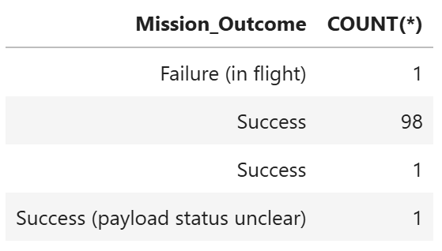
Total Number of Successful and Failure Mission Outcomes
SELECT Mission_Outcome, COUNT(*) FROM SPACEXTABLE GROUP BY Mission_Outcome
Total number of successful and failure mission outcomes
Most missions have been successful, however, there is one mission that failed in flight.

Slide 33
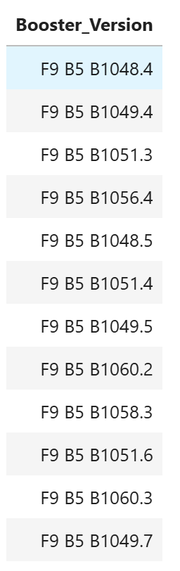
Boosters Carried Maximum Payload
SELECT Booster_Version, COUNT(*) FROM SPACEXTABLE WHERE PAYLOAD_MASS__KG_ = (SELECT MAX(PAYLOAD_MASS__KG_) FROM SPACEXTABLE)
Booster_versions which have carried the maximum payload mass

Slide 34
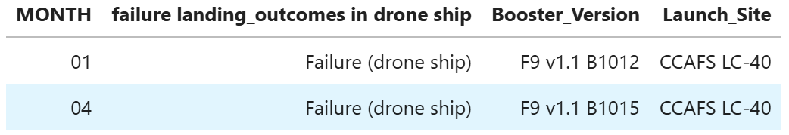
2015 Launch Records
SELECT substr(Date, 6,2) AS MONTH, Landing_Outcome AS 'failure landing_outcomes in drone ship', Booster_Version, Launch_Site FROM SPACEXTABLE WHERE substr(Date,0,5)='2015' AND Landing_Outcome = 'Failure (drone ship)'
Records of the months in year 2015 where was failure landing outcomes
There are 2 failure landing missions this year: one in January and the other one in April
Both of them did not succeed because of drone ship

Slide 35
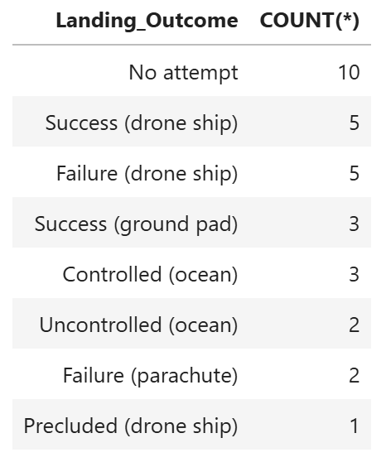
Rank Landing Outcomes Between 2010-06-04 and 2017-03-20
SELECT Landing_Outcome, COUNT(*) FROM SPACEXTABLE WHERE Date BETWEEN '2010-06-04' AND '2017-03-20' GROUP BY Landing_Outcome ORDER BY COUNT(*) DESC;
Most where no attempt
In second place tied are the success and failure of drone ship missions
Then, to a lesser extent, there are those controlled and uncontrolled in the ocean and those failed by the parachute and precluded by drone ship.

Slide 36

Section 3

Slide 37
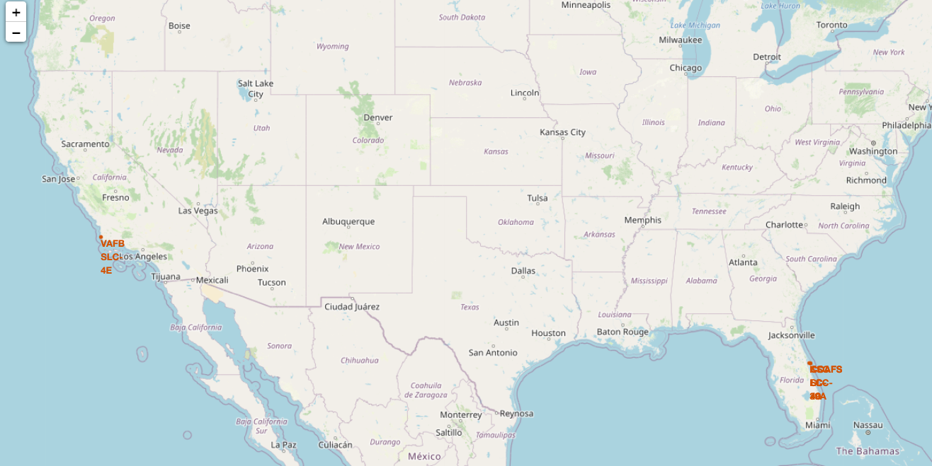
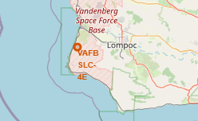
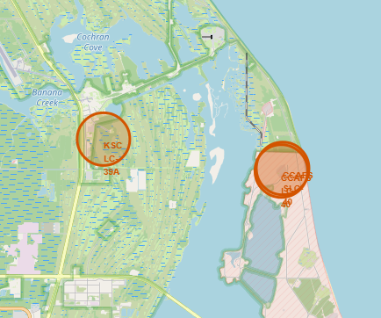
Map of all launch sites
All lauch sites are near the coast
Florida Sites: CCAFS LC-40, CCAFS SLC-40, and KSC LC-39A are located at a latitude of approximately 28.5°N, which is relatively close to the Equator (0° latitude).
California Site: VAFB SLC-4E, located at a latitude of approximately 34.6°N, is farther from the Equator.

Slide 38
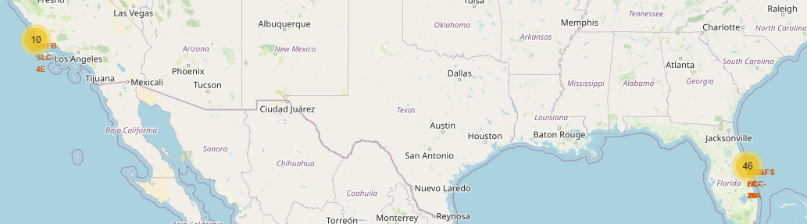
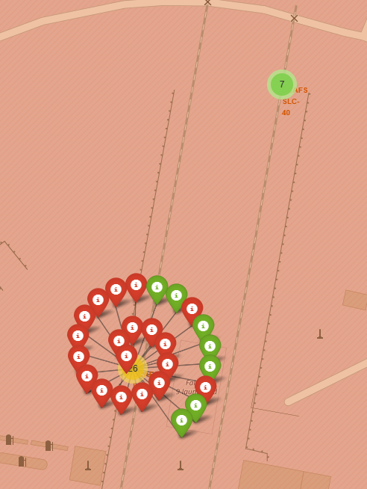
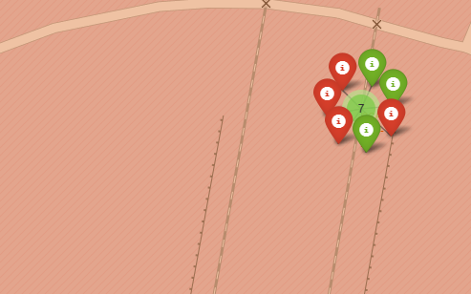
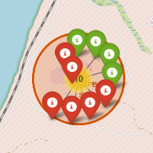
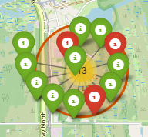
Map pf success/failed launches for each site
CCAFS SLC-40
CCAFS LC-40
KSC LC-39A shows a larger proportion of green markers, indicating a higher success rate.
VAFB SLC-4E also exhibits a good balance of successful launches compared to failures.
CCAFS LC-40 has a mix, with a noticeable cluster of red markers indicating failed launches early on.
VAFB SLC-4E
KSC LC-39A
CCAFS SLC-40 appears to have fewer launches overall but still includes a mix of successes and failures.

Slide 39
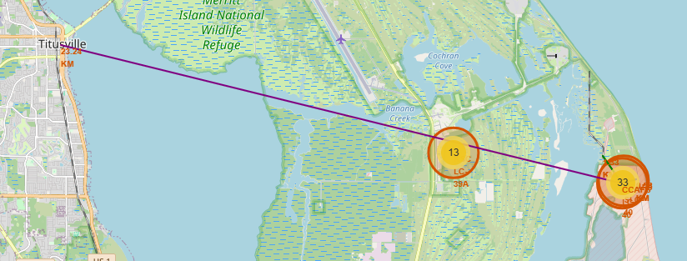
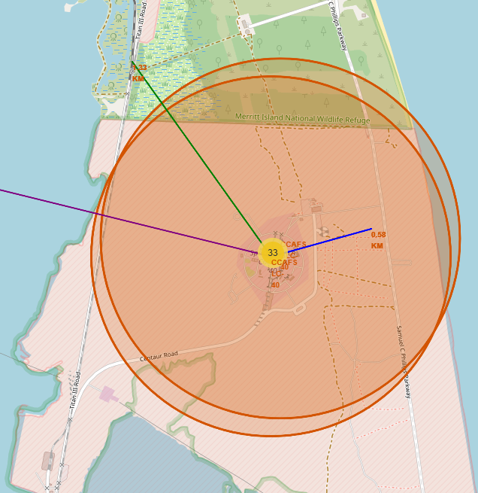
Map of distances between a launch site to its proximities
Railways: Some launch sites may be designed near railways to facilitate the transportation of large components like rockets, which may need rail transport for delivery to the launch pad.
Highways: Launch sites are often located near major highways because it provides quick access for transportation purposes
Coastline: near coastlines to avoid potential risks to populated areas. Launching over the ocean minimizes the risk of damaging properties or causing injuries in case of an accident during launch.
Cities: located at a considerable distance from major cities o ensure safety in case of a launch failure

Slide 40

Section 4

Slide 41
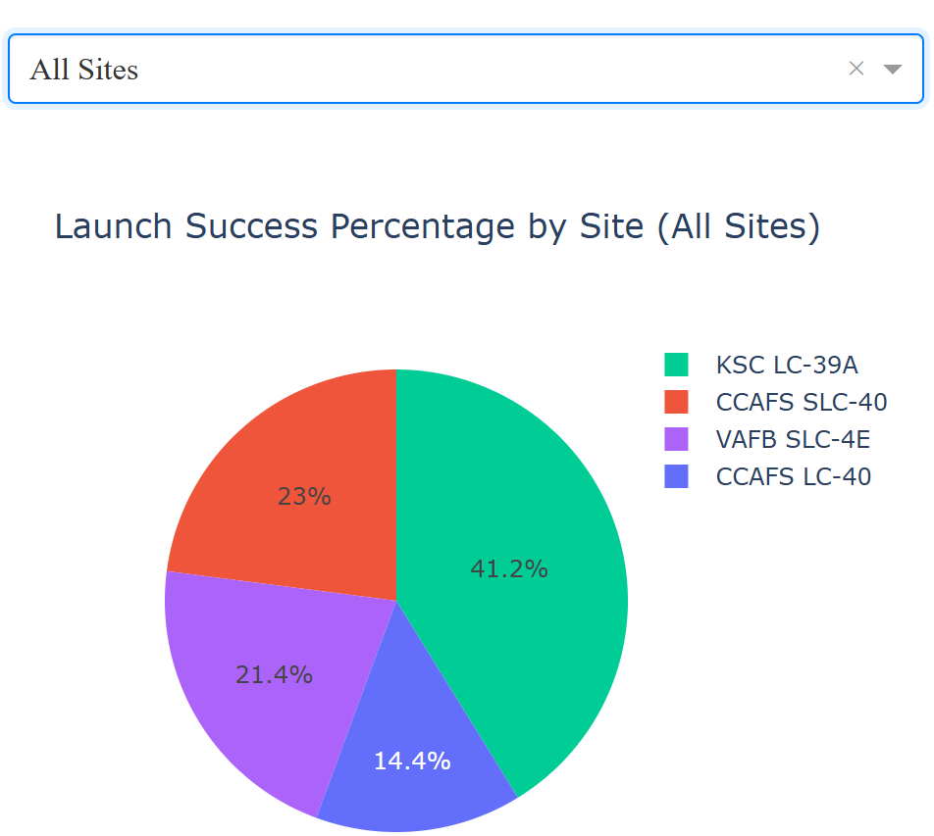
Dashboard Lauch Success Counts for all Sites
KSC LC-39 A has the highest percentage of successful launches at 41.2%. Stands out as the most successful launch site.
CCAFS SLC-40 follows with 23% of successful launches.
VAFB SLC-4E has 21.4% of the successful launches.
CCAFS LC-40 contributes 14.4% to the total successful launches.

Slide 42
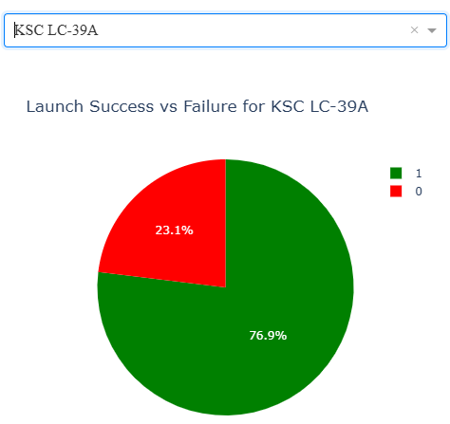
Dashboard launch site with highest launch success ratio
KSC LC-39 A has the highest percentage of successful launches.
The rate of success is 76.9%
Only 23.1% of the misions became un failure

Slide 43
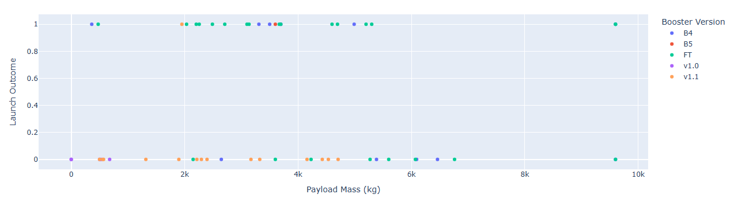
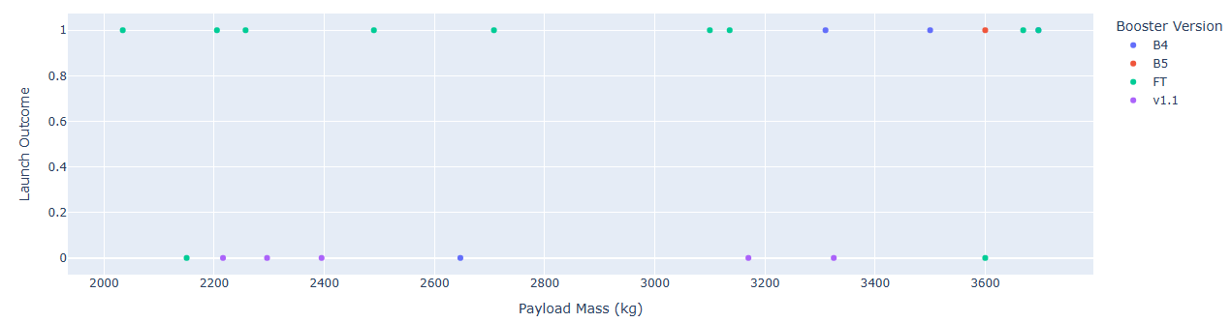
Dashboard of Payload vs. Launch Outcome scatter plot for all sites
0 – 10.000 kg
Booster Version FT has the highest probability of success independently of the payload mass
Booster Version v1.1 and v1.0 have a low probability of success independently of the payload mass
Payload range of 2000 to 4000 kg has the largest success rate
2.000 – 4.000 kg

Slide 44

Section 5

Slide 45
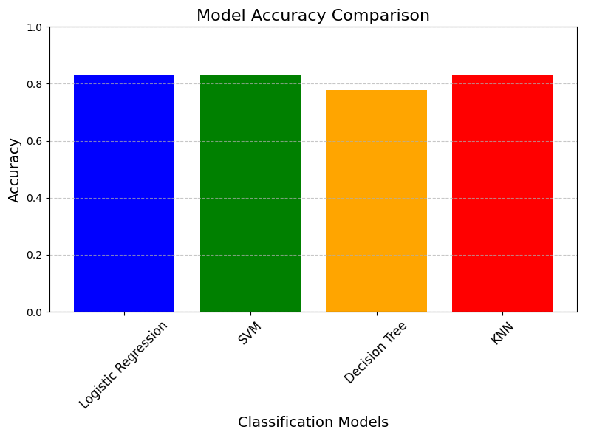
Classification Accuracy
Logistic Regression, SVM, and KNN models all have the highest accuracy of 83.33%
Decision Tree model has a slightly lower accuracy of 77.78%.
This indicates that the Logistic Regression, SVM, and KNN models performed equally well in predicting the launch success, while the Decision Tree model was less effective in comparison.

Slide 46
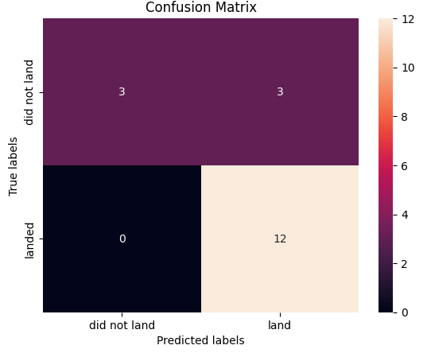
Confusion Matrix of RL, SVM and KNN
The model made no false negatives, meaning it didn't miss any "landed" cases (predicted them as "did not land").
However, it made 3 false positives, incorrectly predicting some "did not land" events as "landed."
Overall, the model performed well, with a high number of true positives (12) and relatively few errors.
This shows that the model is quite accurate at predicting launches that land, but could improve its ability to predict when launches don't land.

Slide 47
Conclusions
We built a predictive model that can estimate the likelihood of a Falcon 9 rocket's first stage successfully landing after a launch. This can be crucial for SpaceX’s operational efficiency and cost analysis, as successful landings reduce the cost of future launches by reusing the rocket's first stage.
Various factors such as the launch site, payload mass, and booster version play a role in the success or failure of a landing. By analyzing these features, we could observe patterns and correlations in the data, which helped us refine our prediction model.
Several machine learning algorithms were evaluated, including Logistic Regression, SVM, Decision Tree, and K-Nearest Neighbors. The best-performing models, Logistic Regression, SVM, and KNN, all achieved similar accuracy rates around 83.33% on the test data.
While the models were accurate, there was room for improvement in terms of handling false positives and understanding the underlying factors that could help further refine our predictions, such as analyzing external variables or improving feature engineering.
The confusion matrix analysis showed that the models performed well in identifying successful landings (True Positives), but some false positives (incorrectly predicting landings) and false negatives (missing landings) could still be improved upon.
Further data collection and model refinement can help improve predictions. For example, incorporating additional features (weather data, time of day, etc.) or using more advanced models such as ensemble methods could potentially increase accuracy.

Slide 48


